Slide 1

2GA3 Tutorial #2
DATE: September 24th, 2021
TA: Jatin Chowdhary
TOPIC: RISC-V Instructions

Slide 2


Slide 3
First Time
Ask questions
Give feedback
Point out my mistakes
Criticism is welcomed
Don’t be shy/afraid
  Not marking
If I forget something, tell me!
  Won’t nail every single point
  Often times, it’ll come to me hours later (or in the shower)

Slide 4
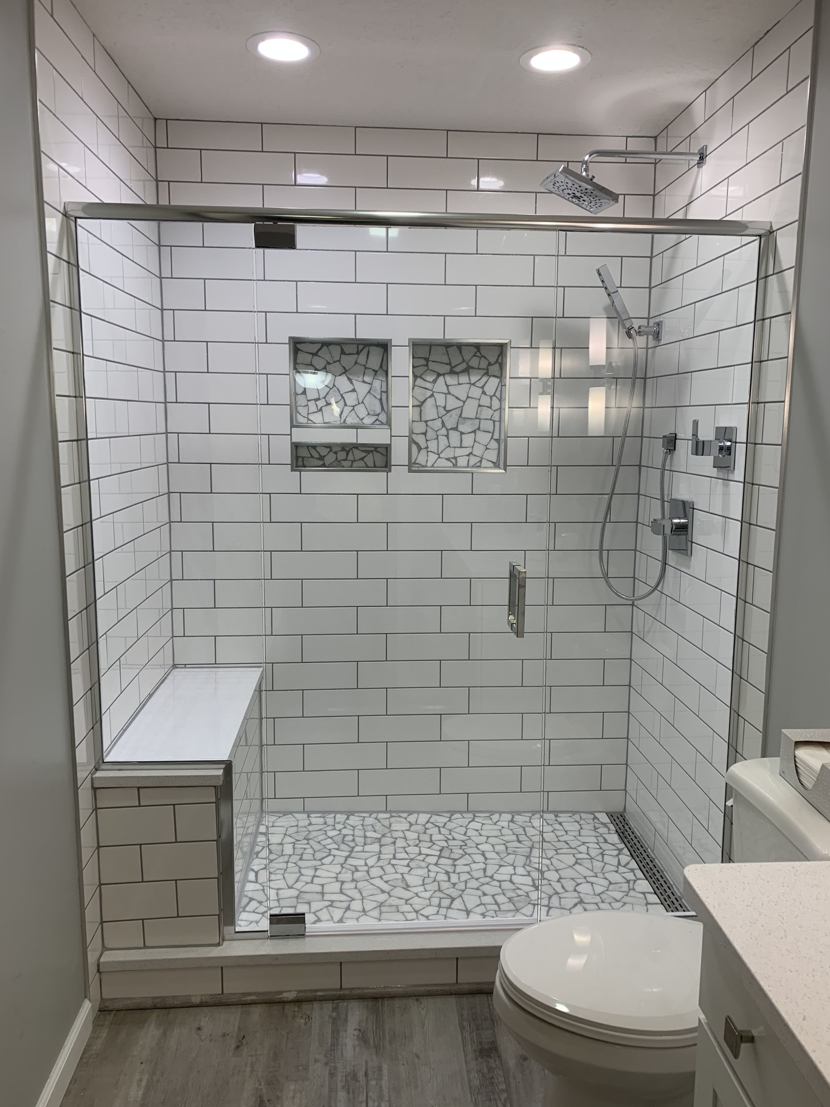
Ideas Start Here...

Slide 5
Stay Safe
Everyone I know is getting into car accidents
  Cousin
    2 accidents in the span of 3 months
  Neighbour
    1 week ago
  Me
    ~ 1 month ago
    Got rear-ended on the highway
    His fault
Watch out and take care!

Slide 6
Other Stuff (1)
Avoid sitting on the right side
  Harder to see blackboard when I’m writing
    I’m right handed
When you come to class:
  Be enthusiastic
  Have a lot of questions
    It’s better to ask questions, than it is to take notes
      Everything is, or will be, posted
  Sit up straight
  Phones on silent
  Laptops tucked away

Slide 7
Other Stuff (2)
Not (officially) taking attendance
  But I will keep track, mentally
    What does this mean?
Still learning your names
  Give it time
Assignment questions
  Direct them to Peter
Haven’t seen the assignment
  Not going to
  Avoid bias

Slide 8
Quick Review
Question: There are 3 processors, {i3, i5, i7}. The i3 processor has a clock rate of 4.5 GHz and a CPI of 1.5. The i5 processor has a clock rate of 3.0 GHz and a CPI of 1.5. The i7 processor has a clock rate of 3.8 GHz and a CPI of 1.5. Which processor has the highest performance? Assume all processors have the same architecture, and no other differences are present.

Slide 9
Answer
The i3 processor is the fastest
  It has the highest clock rate
  CPI is irrelevant because they’re all the same
    No other differences are stated
  No need to convert GHz to Hz
    But only for this question
    If this question had a part (b), then a conversion would probably be required
    10⁹ is a constant, c

Slide 10
CPI
CPI: Clock Cycles Per Instruction
Recall that CPI differs based on:
  Program
  Processor
  Architecture
  Implementation

Slide 11
Implementation
Why does implementation matter?
  Simple example of copy/paste VS. duplicate and how it affects the clipboard
    Duplicate does not affect the clipboard, and if it does, it reverts the changes

Slide 12
Lecture Question
Question: Between lw and add, which instruction takes more time? Assume that lw is used to load data from memory, and add is used to add data already in registers.
Options:
  A) Load
  B) Add
  C) Same time
  D) Depends on the weather outside
Answer: D

Slide 13
Register
What is a register?
  Best question from last week
  Asked by Melissa
    Thank you Melissa
  The basis of everything
    Simple question, but very broad
  Pay attention
    This is very useful!

Slide 14


Slide 15
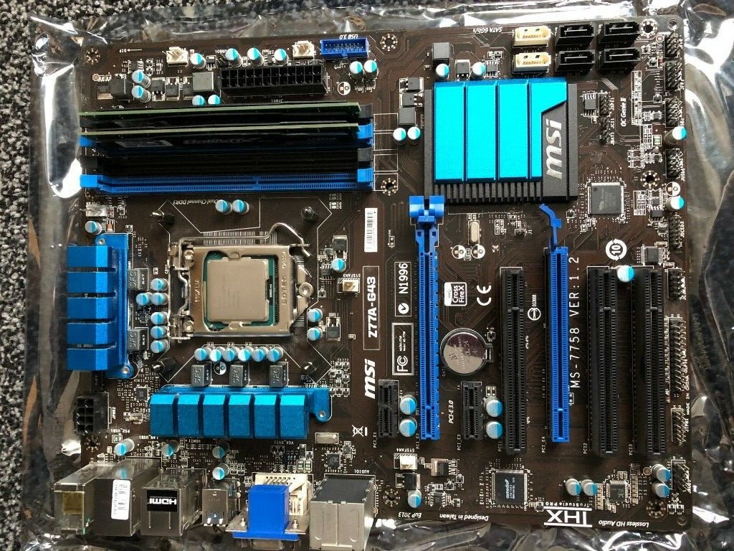

Slide 16
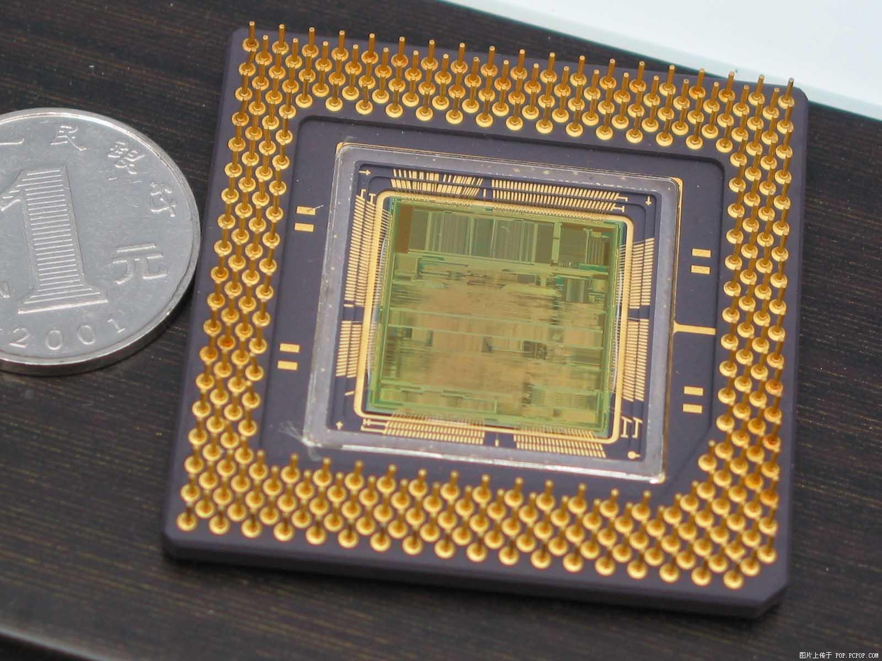

Slide 17
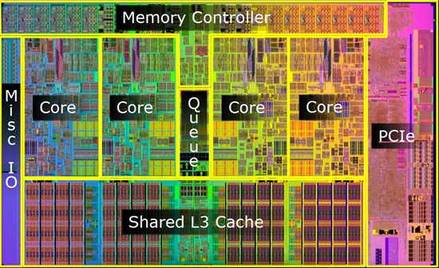

Slide 18
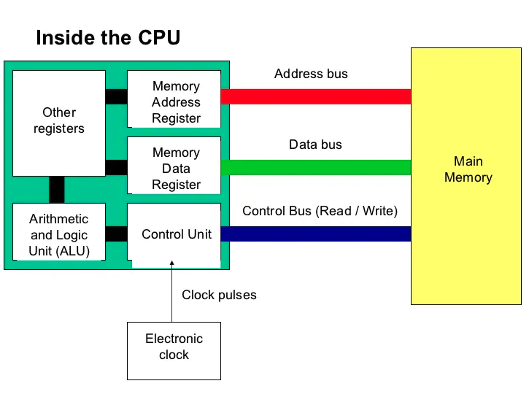

Slide 19
Recap
Registers are in the CPU
Each core has its own set of registers
Registers are used to store, accept, and transfer instructions and data
  i.e. Modifying an image
  i.e. Playing a video game
  Anytime you use a computer, registers are used

Slide 20
Practical Example
Now let’s connect it all
  Program In C → Compile to assembly
  Assembly → Machine code (Instructions)
  Machine code runs in the CPU
  Information is exchanged over the BUS
    BUS connects the RAM and CPU
      This is not a school bus
        But it is magical

Slide 21
CMOS/PMOS
I’ll try to explain it next week
  No time today
    (We’re always running out of time)

Slide 22
Architecture
32-bit VS. 64-bit
  Will be explained next week
  Relates to register size
    The bigger the register, the more information we can shove; we can do more
      i.e. Moving houses (Use your car OR rent a U-Haul)

Slide 23
Question 1
For the following C statement, write the corresponding RISC-V assembly code. Assume that the C variables f, g, and h, have already been placed in registers x5, x6, and x7, respectively. Use a minimal number of RISC-V assembly instructions.
f = g + (h − 5);

Slide 24
Solution
addi x5, x7, -5 # f = h – 5
add x5, x5, x6 # f = g + f
addi stands for add immediate
  Used for constants
    i.e. 2, 3, 5, etc.
add is used to sum values that are already in registers
  Values must be loaded, via lw, before they can be added
Note: There is no subi

Slide 25
Quick Review 1
What is the largest unsigned value you can fit in a 32-bit register?
Options:
  2³²
  2³¹
  2³² – 1
  2³¹ – 1
  None of the above
Example: C Program

Slide 26
Question 2
For the following C statement, write the corresponding RISC-V assembly code. Assume that the variables f, g, h, i, and j are assigned to registers x5, x6, x7, x28, and x29, respectively. Assume that the base address of the arrays A and B are in registers x10 and x11, respectively.
B[8] = A[i−j];

Slide 27
Solution (1)
32-bit
  sub x30, x28, x29 // Compute [i – j]
  slli x30, x30, 2 // Multiply by 4 to get byte offset
  add x10, x10, x30 // Calculate memory location
  lw x30, 0(x10) // Load A[i – j]
  sw x30, 32(x11) // Store in B[8]
But wait, what about 64-bit?

Slide 28
Solution (2)
32-bit
  sub x30, x28, x29 // Compute [i – j]
  slli x30, x30, 2 // Multiply by 4 to get byte offset
  add x10, x10, x30 // Calculate memory location
  lw x30, 0(x10) // Load A[i – j]
  sw x30, 32(x11) // Store in B[8]
64-bit
  sub x30, x28, x29 // Compute [i – j]
  slli x30, x30, 3 // Multiply by 8 to get byte offset
  add x10, x10, x30 // Calculate memory location
  ld x30, 0(x10) // Load A[i – j]
  sd x30, 64(x11) // Store in B[8]

Slide 29
Quick Review 2
What is the largest signed value you can fit in a 64-bit register?
Options:
  2⁶⁴
  2⁶³
  2⁶⁴ – 1
  2⁶³ – 1
  None of the above
Example: C Program

Slide 30
Question 3
Translate the following C code to RISC-V. Assume that the variables f, g, h, i, and j are assigned to registers x5, x6, x7, x28, and x29, respectively. Assume that the base address of the arrays A and B are in registers x10 and x11, respectively. Assume that the elements of the arrays A and B are 8-byte words.
B[8] = A[i] + A[j];

Slide 31
Solution (1)
32-bit
  slli x28, x28, 2 # x28 = i * 4
  add x28, x10, x28 # x28 = &A[0] + i * 4
  lw x28, 0(x28) # x28 = A[i]
  slli x29, x29, 2 # x29 = j * 4
  add x29, x10, x29 # x29 = &A[0] + j * 4
  lw x29, 0(x29) # x29 = A[j]
  add x28, x28, x29 # x28 = A[i] + A[j]
  sw x28, 32(x11) # store result in B[8]
Solution provided by Mingzhe Wang

Slide 32
Solution (2)
64-bit
  slli x28, x28, 3 # x28 = i * 8
  add x28, x10, x28 # x28 = &A[0] + i * 8
  ld x28, 0(x28) # x28 = A[i]
  slli x29, x29, 3 # x29 = j * 8
  add x29, x10, x29 # x29 = &A[0] + j * 8
  ld x29, 0(x29) # x29 = A[j]
  add x28, x28, x29 # x28 = A[i] + A[j]
  sd x28, 64(x11) # store result in B[8]
Solution provided by Mingzhe Wang

